Slide 1
Weekly Reporting

Slide 2

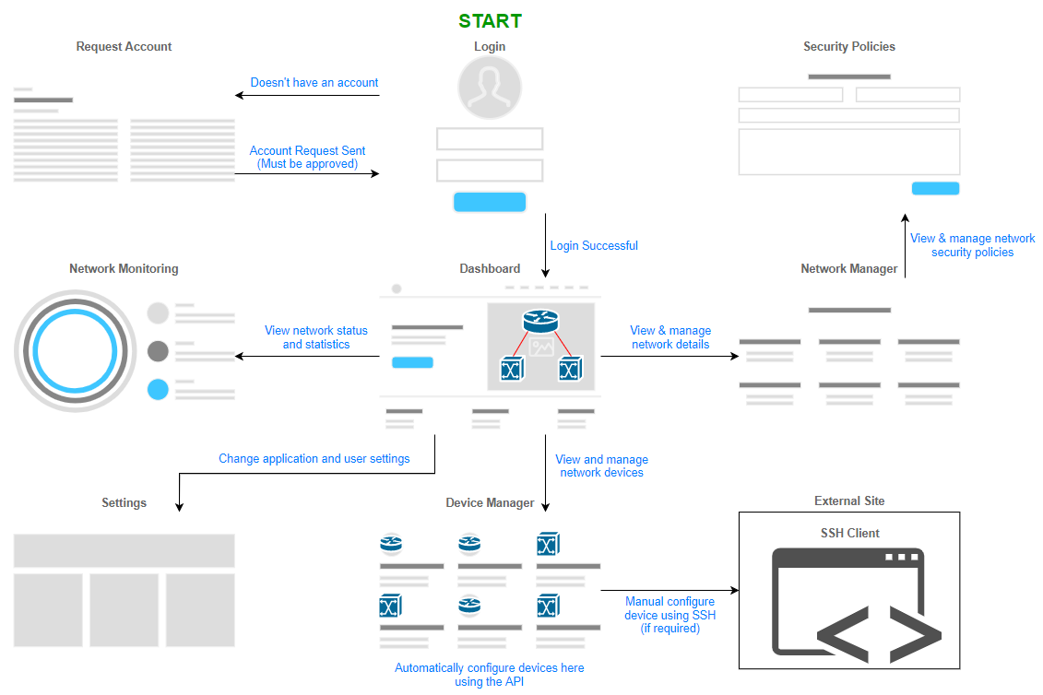
User Flow/Storyboard

